Slide 1
STANFORD CS 147: INTRODUCTION TO HUMAN-COMPUTER INTERACTION
ASSIGNMENT 1
Needfinding
SARAH JACOB, STEVEN LE, KRYSTAL LI, & LAUREN YU

Slide 2
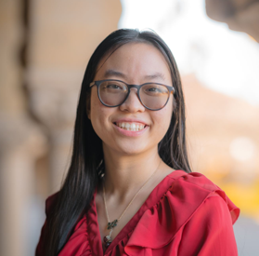
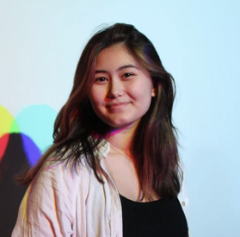

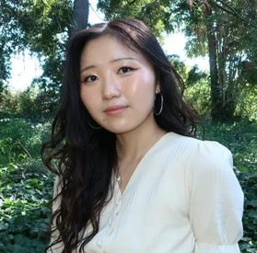
INTRODUCTION
A1: NEEDFINDING
Team Members
Krystal Li
Junior
Symbolic Systems, HCI
Miami, FL
Sarah Jacob
Senior
Design, AI + UX
Brick, NJ
Steven Le
Senior
Computer Science, HCI
Phoenix, AZ
Lauren Yu
Junior
Computer Science, HCI
Brea, CA

Slide 3
A1: NEEDFINDING
Domain Selection

Slide 4
DOMAIN SELECTION
A1: NEEDFINDING
Our initial domain selection began with a brainstorming session about behaviors we were interested in.
MENSTRUAL CYCLE
GOING TO THE GYM
NUTRITION
EXERCISE
GAMES
SELF-CARE
SCREEN TIME
DOOM SCROLLING
GOING OUTSIDE

Slide 5
DOMAIN SELECTION
A1: NEEDFINDING
We found a common theme that we chose to explore as our domain…
Keeping track of important health-related information
MENSTRUAL CYCLE
GOING TO THE GYM
NUTRITION
EXERCISE
GAMES
SELF-CARE
SCREEN TIME
DOOM SCROLLING
GOING OUTSIDE
Improving one’s accountability
Digital distractions

Slide 6
DOMAIN SELECTION
A1: NEEDFINDING
We decided to explore the domain of personal & social accountability.
Specifically, we wanted to understand how people hold themselves accountable for the tasks they need to do.
We also wanted to learn more about how external factors can affect someone’s accountability.

Slide 7
A1: NEEDFINDING
Needfinding Methodology

Slide 8



NEEDFINDING METHODOLOGY
A1: NEEDFINDING
Locating Participants
Non-Stanford Affiliated
Variety of Tasks
Diversity
We wanted our user research to be representative of more perspectives than just those in the Stanford bubble.
With accountability, there has to be things you’re keeping accountable for. We wanted to learn more about a variety of tasks:
Schoolwork?
Chores?
Job-Related?
We wanted to represent a diverse range of perspectives & life experiences. Thus, we looked for diversity in:
Age
Gender
Careers
Notes:
Different age groups (teens, young adults, adults, and seniors)
Varied priorities, considering students, parents, working adults, and retirees.
Different levels of reliance on technology and social media.

Slide 9
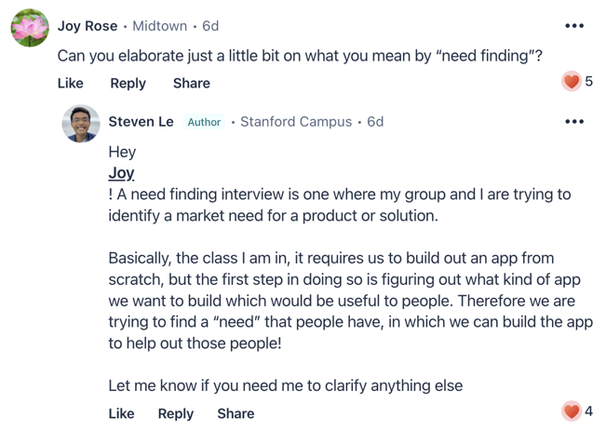
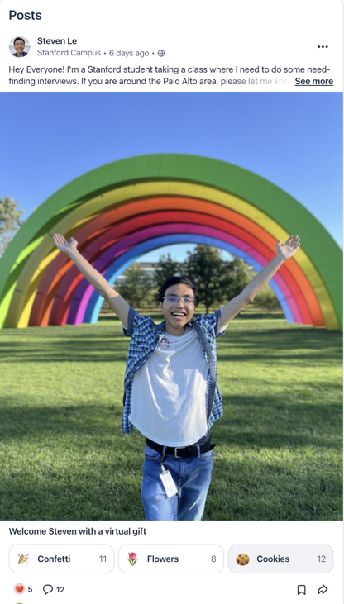
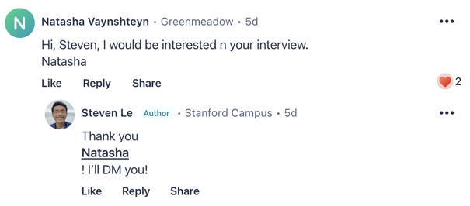
NEEDFINDING METHODOLOGY
A1: NEEDFINDING
Notes:
Nextdoor
also posted on Facebook groups

Slide 10
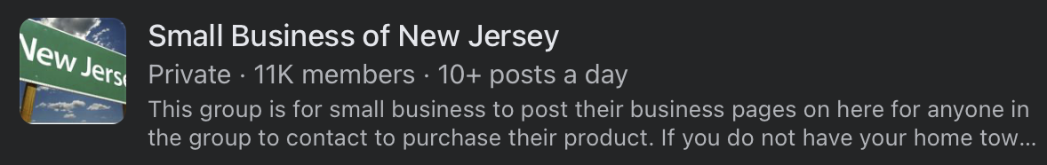
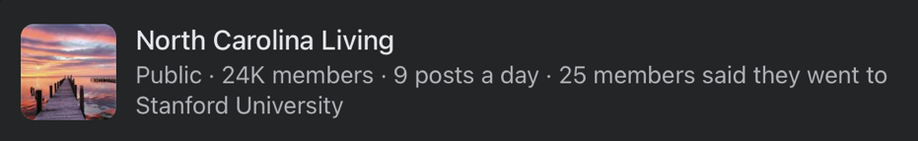

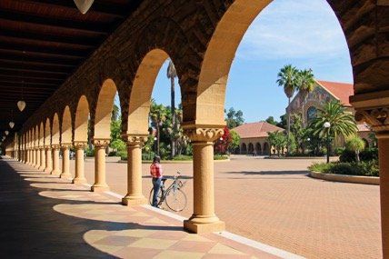
NEEDFINDING METHODOLOGY
A1: NEEDFINDING
Notes:
Nextdoor
also posted on Facebook groups
Downtown Palo Alto & tourists at Main Quad

Slide 11

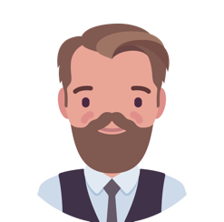
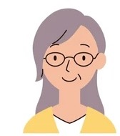
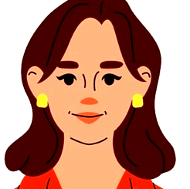

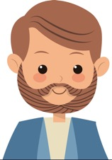
NEEDFINDING METHODOLOGY
A1: NEEDFINDING
We interviewed…
Andrew
17 yrs old
High School Senior
Raleigh, NC
JJ
22 yrs old
College Student + Caregiver
San Francisco, CA
Ann
66 yrs old
Retired Librarian
Santa Clara, CA
Madison
21 yrs old
ROTC Nursing Student + Business Owner
South Orange, NJ
Alex
56 yrs old
Mortgage Banker
Richmond, VA
Notes:
Where were the interviews conducted?
Team member roles for each interview
Apparatus – any equipment/software used (transcribing, etc.)
rubric:
location, recruitment, compensation, script, apparatus, etc.

Slide 12






NEEDFINDING METHODOLOGY
A1: NEEDFINDING
WHY these participants?
Age Range
17
21
22
56
66
Wide Range of Daily Responsibilities
Gender and Income Diversity
Willingness to Speak to Us
Notes:
Where were the interviews conducted?
Team member roles for each interview
Apparatus – any equipment/software used (transcribing, etc.)
rubric:
location, recruitment, compensation, script, apparatus, etc.

Slide 13

NEEDFINDING METHODOLOGY
A1: NEEDFINDING
Our Interview Plan
WHERE: Conducted 3 in-person interviews, 2 on Zoom
WHEN: After outreach, scheduled meetings based on participants’ availability
SCRIPT: Emphasis on listening to the user’s stories, asking “why”
APPARATUS: Zoom and audio recordings, or written notes
ETHICS: Coffee on us for their time, established trust through conversation
LENGTH: Our interviews ranged from 25 minutes to 50 minutes
PROCEDURE: Most interviews had 2 people, one interviewing, another taking notes
Notes:
WHEN: also working with timezones
SCRIPT: and focusing on emotions (Challenges, Motivations, Success)
APPARATUS: With consent, recorded Zoom participants, audio recorded one in-person interview, and took notes for the other in-person interviews
ETHICS: We offered them coffee on us for their time, established trust through conversation, made it feel like a conversation and not transactional

Slide 14
NEEDFINDING METHODOLOGY
A1: NEEDFINDING
We asked about…
current methods,
challenges,
success,
and next steps.
How do you keep yourself accountable?
What do you keep yourself accountable for?
What are some of the biggest challenges you face when keeping accountable?
What habits or practices have you developed over time to improve your accountability?
How do you think technology could help you stay on track?

Slide 15
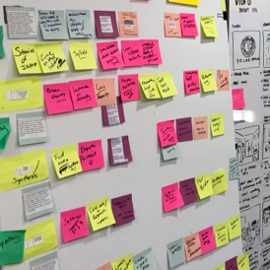
RESULTS & ANALYSIS
A1: NEEDFINDING
Results & Analysis

Slide 16
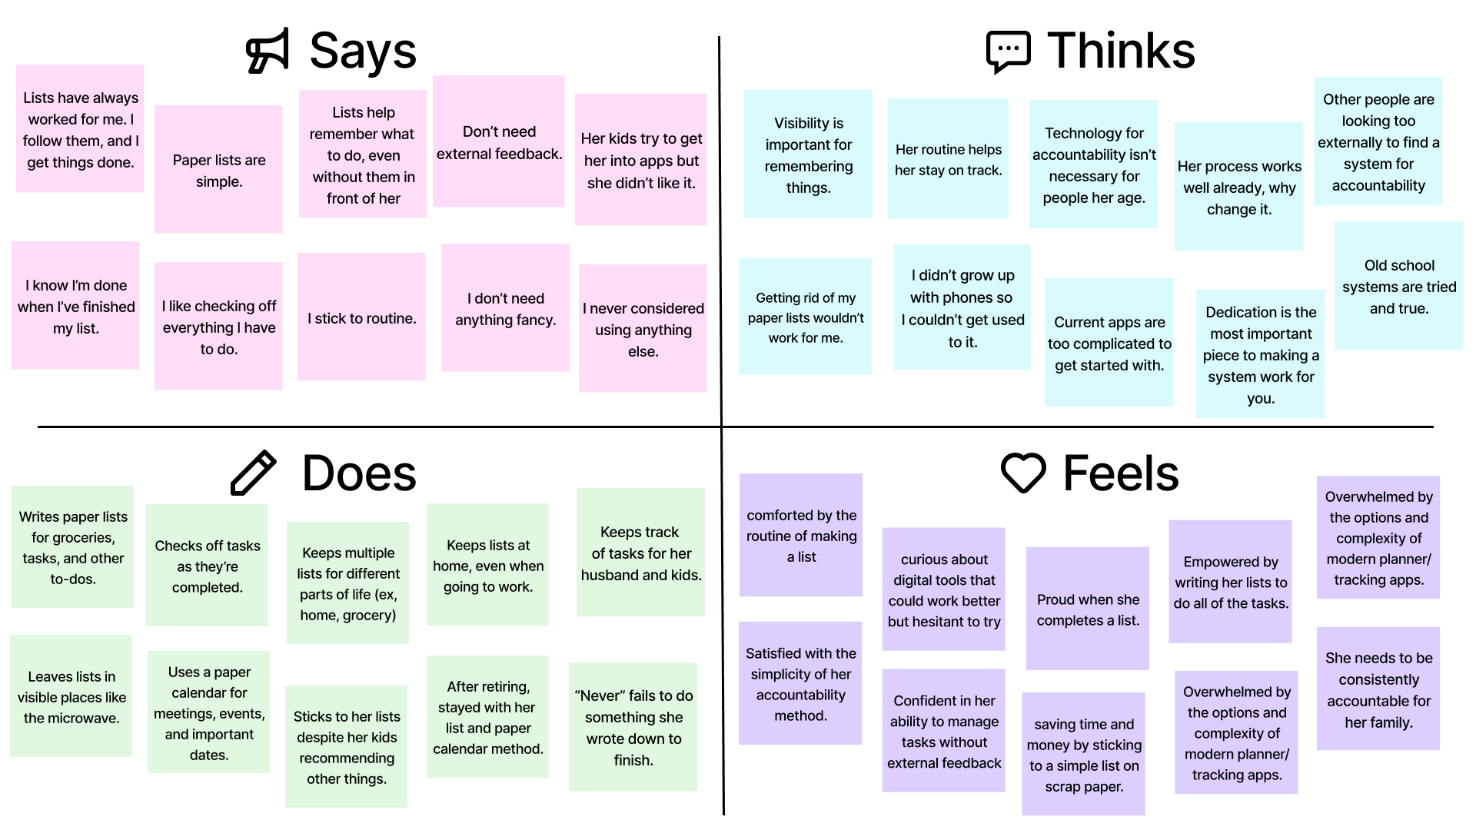

Empathy Map: Ann
RESULTS & ANALYSIS
A1: NEEDFINDING

Slide 17
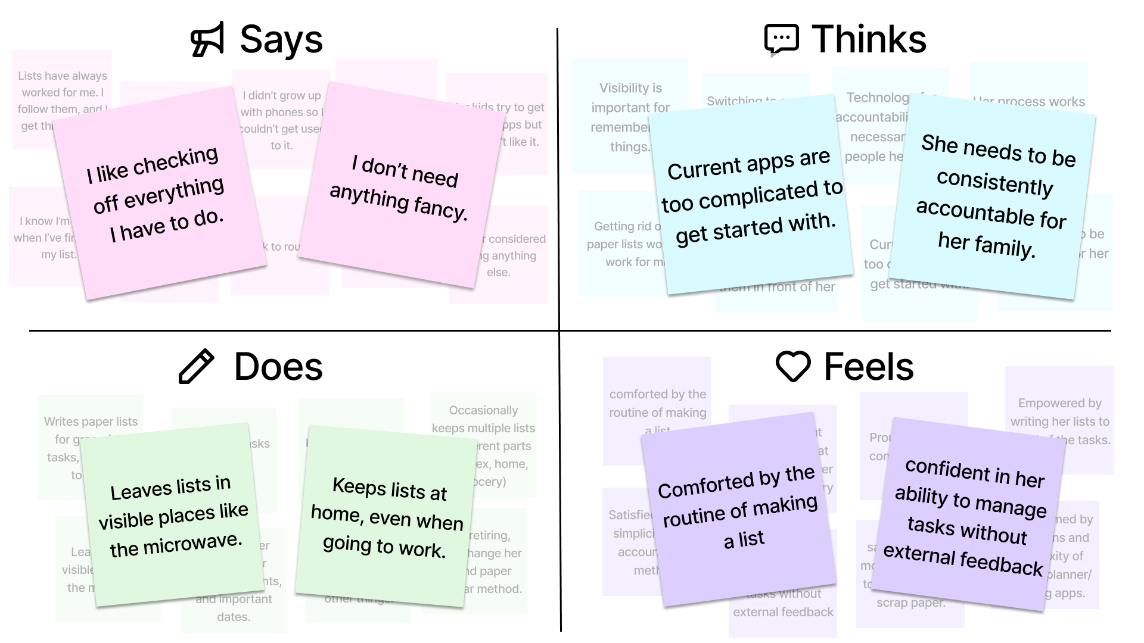
Empathy Map: Ann
RESULTS & ANALYSIS
A1: NEEDFINDING

Slide 18
RESULTS & ANALYSIS
A1: NEEDFINDING
Insight
People prefer simple, familiar systems to manage their tasks because these methods provide a sense of control and independence. People who have strong sense of routine value following one without needing external feedback or complicated technology to feel productive.
Need
Users need a way to maintain their sense of accomplishment and control in staying accountable. People seek methods that support their existing habits and preferences while ensuring they stay organized and carry out their commitments.

Slide 19
RESULTS & ANALYSIS
A1: NEEDFINDING
Key Quote
“I like checking off everything I have to do and then I know I’m done. It’s simple, I just do what I planned and I can’t go wrong.”
Surprises
Ann said she exclusively uses her paper lists and calendar to remember things, but she doesn’t bring these to work.
Ann said that the act of writing things helps her to remember what she needs to do, even without the lists in front of her.
Ann said she can’t remember ever losing a list that she needed.

Slide 20
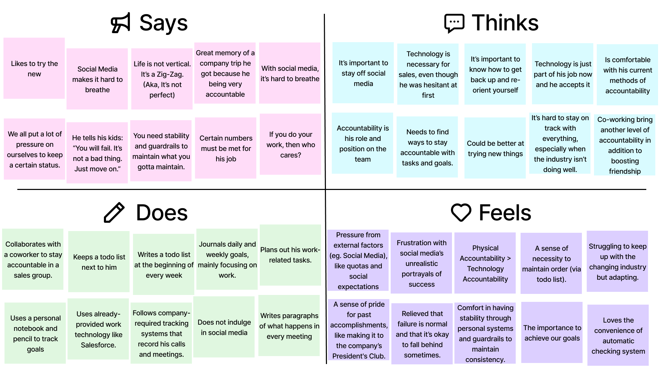

Empathy Map: Alex
RESULTS & ANALYSIS
A1: NEEDFINDING

Slide 21
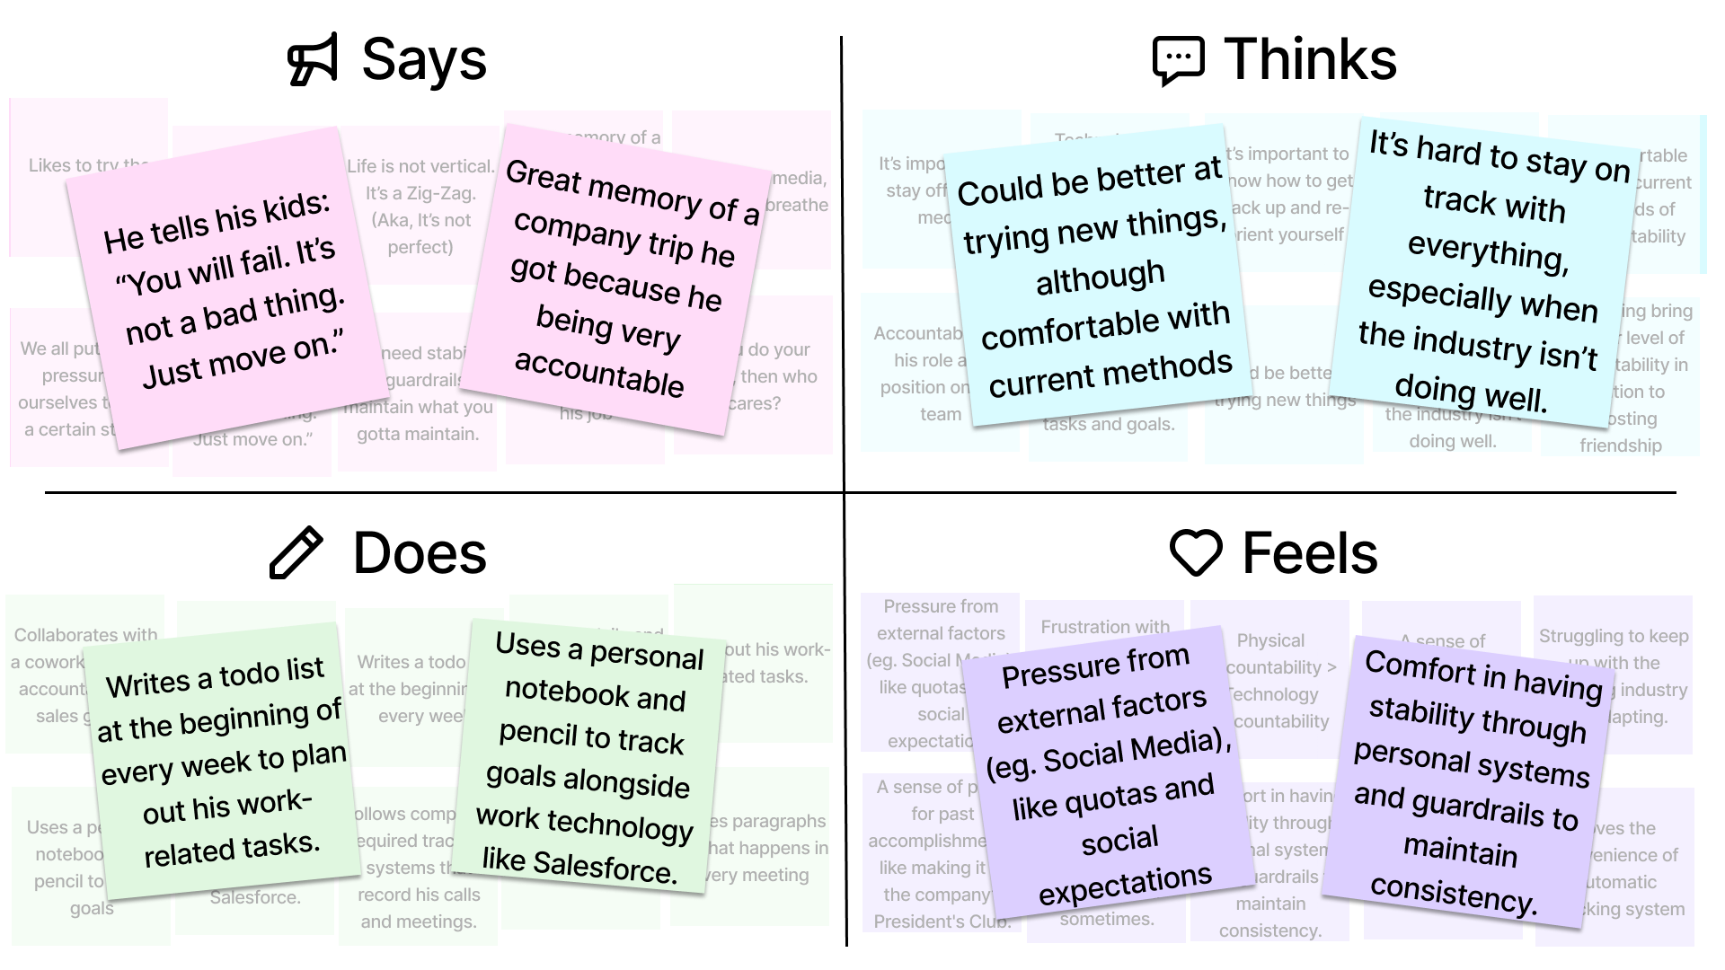
Empathy Map: Alex
RESULTS & ANALYSIS
A1: NEEDFINDING

Slide 22

RESULTS & ANALYSIS
A1: NEEDFINDING
Insight
People value stability and consistency in an unpredictable work environment, but also acknowledges the inevitability of failure and the importance of being able to adapt. Adapting is an integral part of the job, and people find comfort in simple, reliable methods.
Need
Users need tools or systems that help them stay accountable and maintain stability, while also allowing them flexibility to adjust when things don’t go according to plan. These tools should integrate with their work, support their existing habits, and provide guardrails that prevent them from falling too far behind.

Slide 23
RESULTS & ANALYSIS
A1: NEEDFINDING
Key Quotes
“I have my own written todo list at my work desk that I make at the beginning of each week detailing the goals I set.”
Surprises
Only utilizes technology for his work
Is comfortable with failure, granted he is able to learn and improve.
Loves the reliable, easy methods that he is used to, but still wants to try the new.
Does not like social media

Slide 24
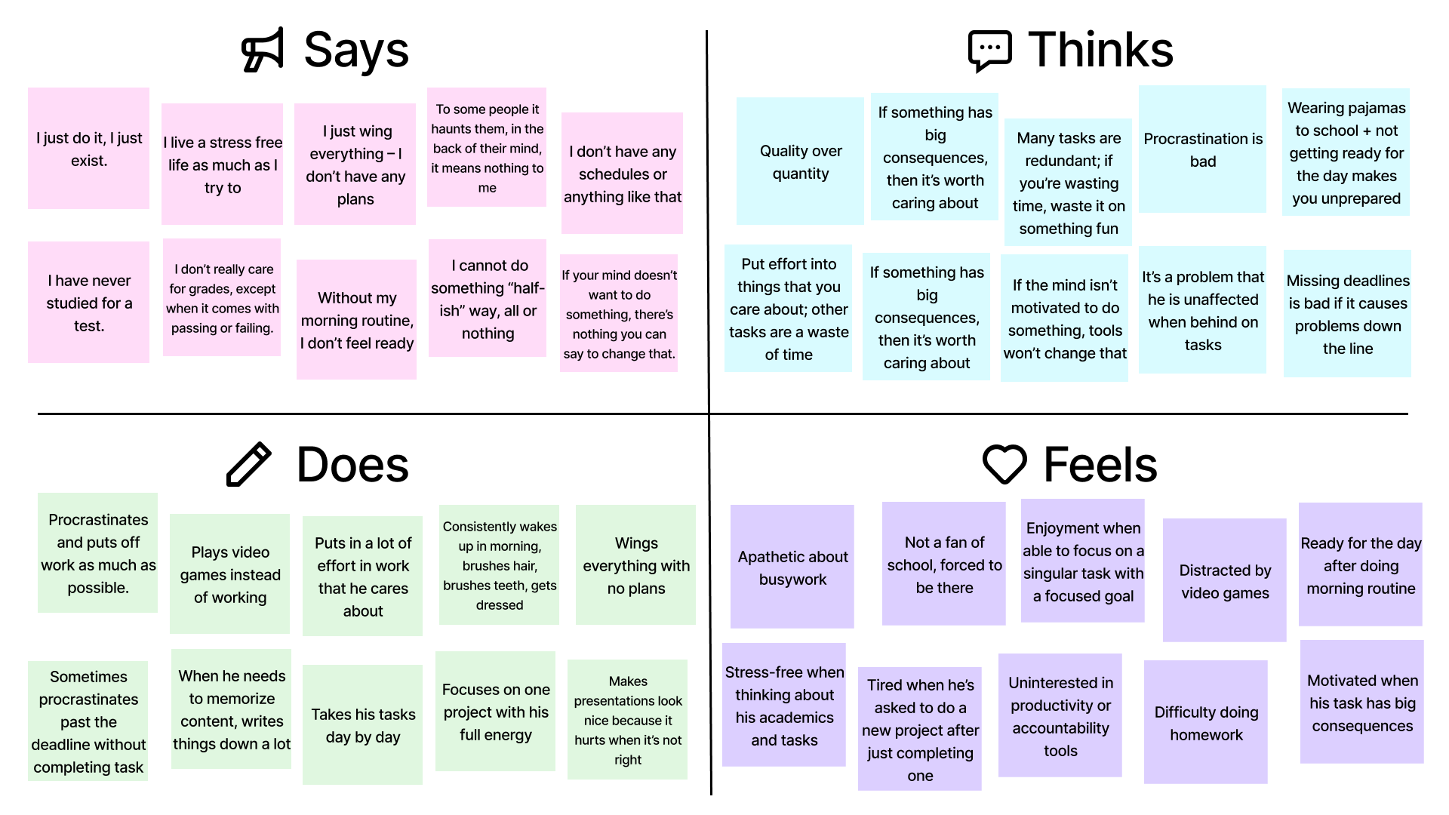

Empathy Map: Andrew
RESULTS & ANALYSIS
A1: NEEDFINDING

Slide 25
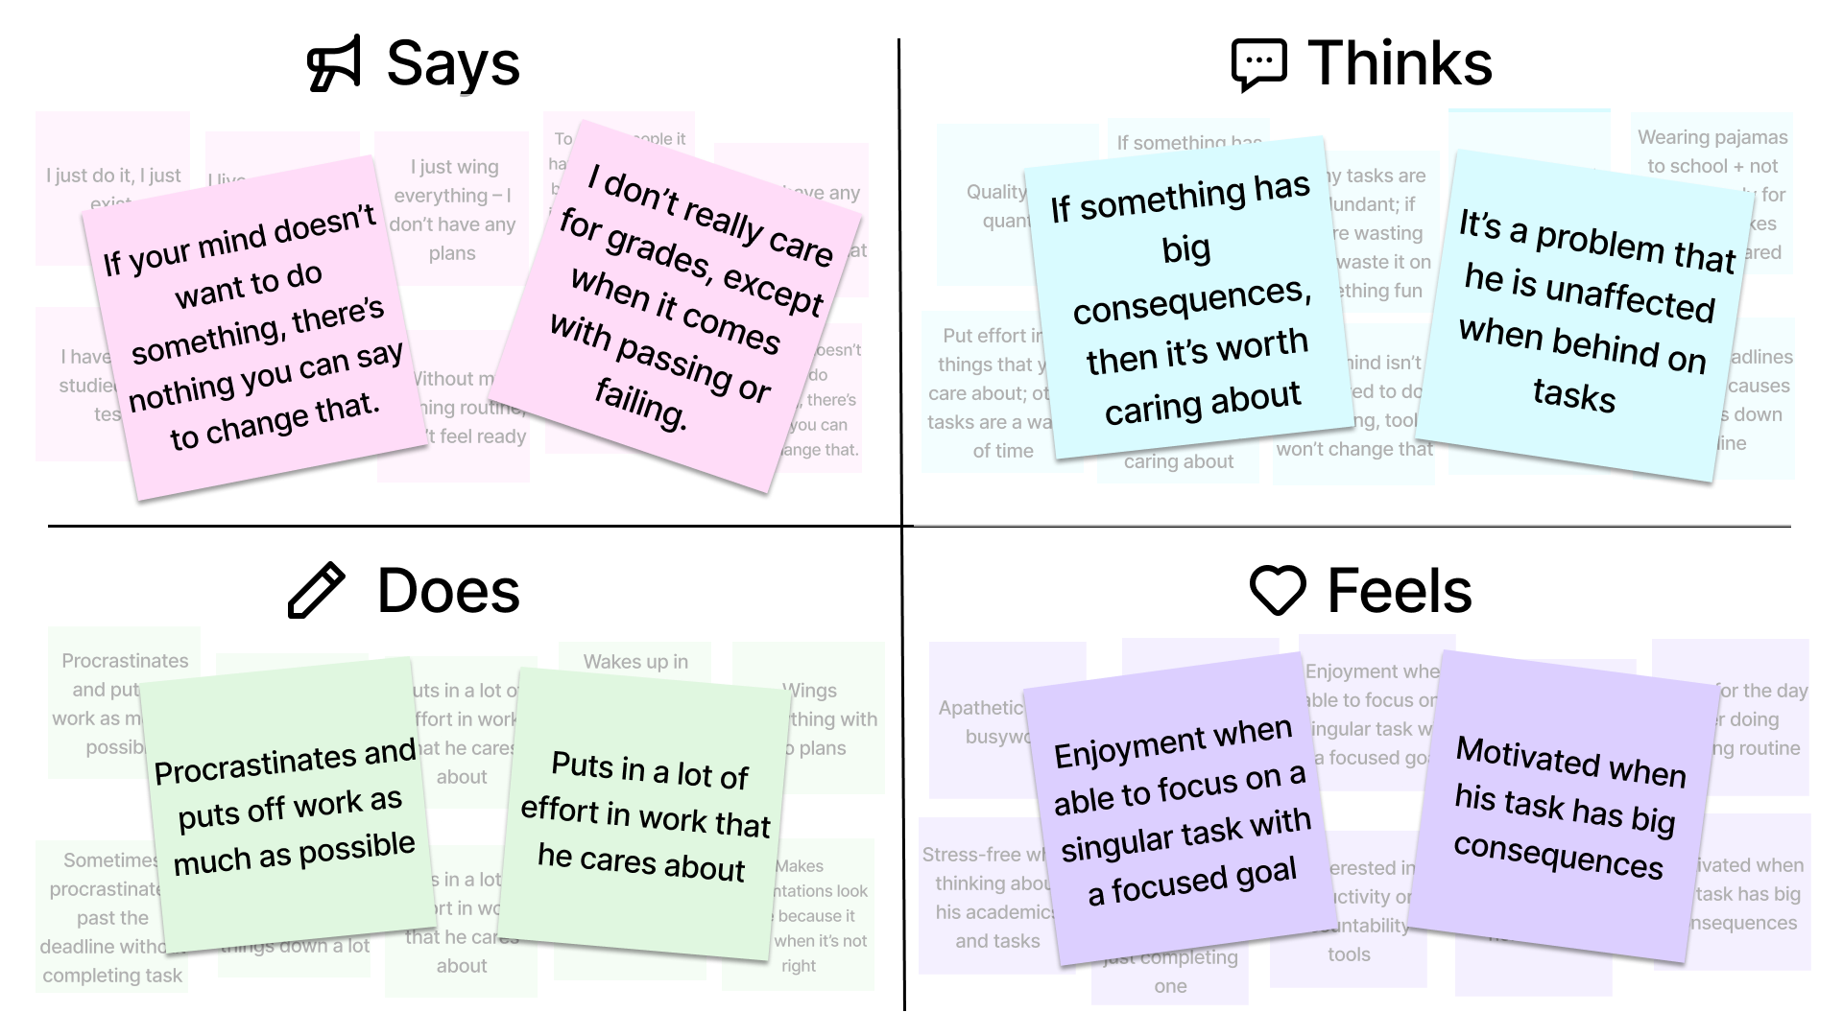
Empathy Map: Andrew
RESULTS & ANALYSIS
A1: NEEDFINDING

Slide 26

RESULTS & ANALYSIS
A1: NEEDFINDING
Insight
Some people are motivated to do work only when it is personally meaningful to them and has big consequences. Otherwise, they might not feel compelled to put in the work or take on a lot of different obligations. Instead, they may enjoy a comfortable routine that gets them through the day.
Need
Users need to feel motivated to do their tasks in the first place. Tools can help them recognize consequences of their procrastination and find it fun to complete the tasks overall. They should provide compelling motivation to get the user started on what they need to accomplish.

Slide 27
RESULTS & ANALYSIS
A1: NEEDFINDING
Key Quotes
“I’m a firm believer in quality over quantity. If someone tells me to do a slideshow, I put all my energy into that one slideshow... I cannot do something halfway; it’s all or nothing.”
Surprises
No formal accountability system
Indifferent to deadlines
Perfectionist
Emphasizes routine and stress-free life

Slide 28
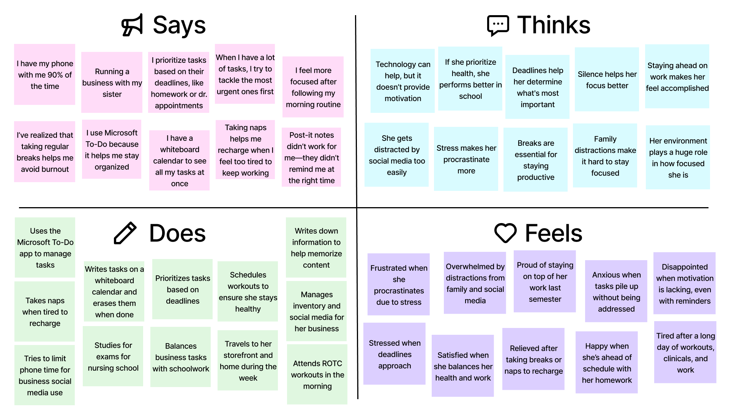


Empathy Map: Madison
DOMAIN SELECTION
A1: NEEDFINDING

Slide 29
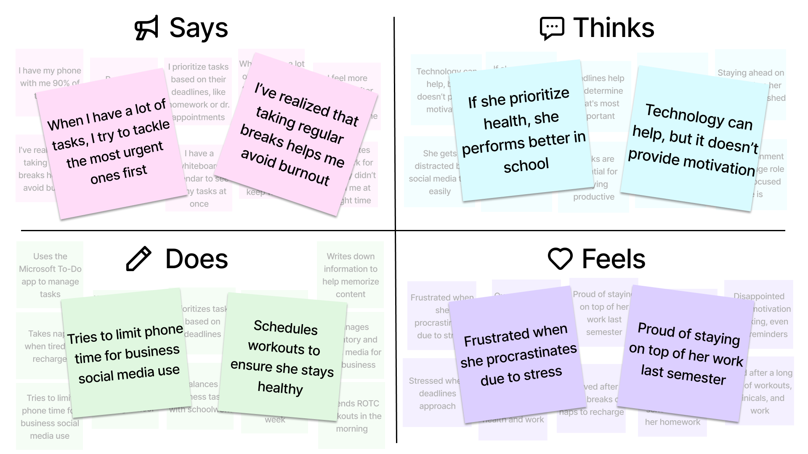
Empathy Map: Madison
DOMAIN SELECTION
A1: NEEDFINDING

Slide 30

RESULTS & ANALYSIS
A1: NEEDFINDING
Insight
Many users struggle with accountability, not due to a lack of organization but because of low motivation. Even with tools like apps and calendars, distractions (such as social media, family, and their environment) and procrastination often prevent them from completing tasks.
Need
Users need tools that do more than remind them—they should provide motivation, reduce distractions, and break tasks into manageable steps. These tools should help users feel accomplished and maintain focus, making tasks more engaging and achievable.

Slide 31
RESULTS & ANALYSIS
A1: NEEDFINDING
Key Quotes
"My biggest challenge is motivation. The apps remind you of things to do, but they don't motivate you to actually do them."
Surprises
Minimal use of written tools
Aware of social media distractions, still gets distracted even with limits
Prioritizes her health
Uses Microsoft To-Do

Slide 32
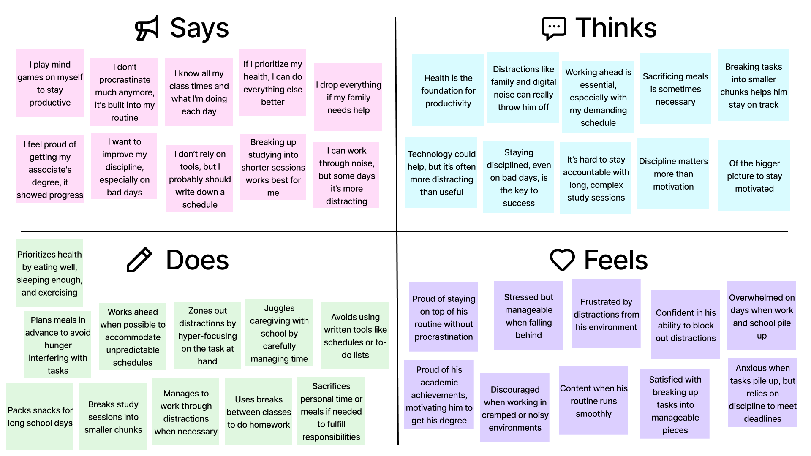

Empathy Map: JJ
DOMAIN SELECTION
A1: NEEDFINDING

Slide 33
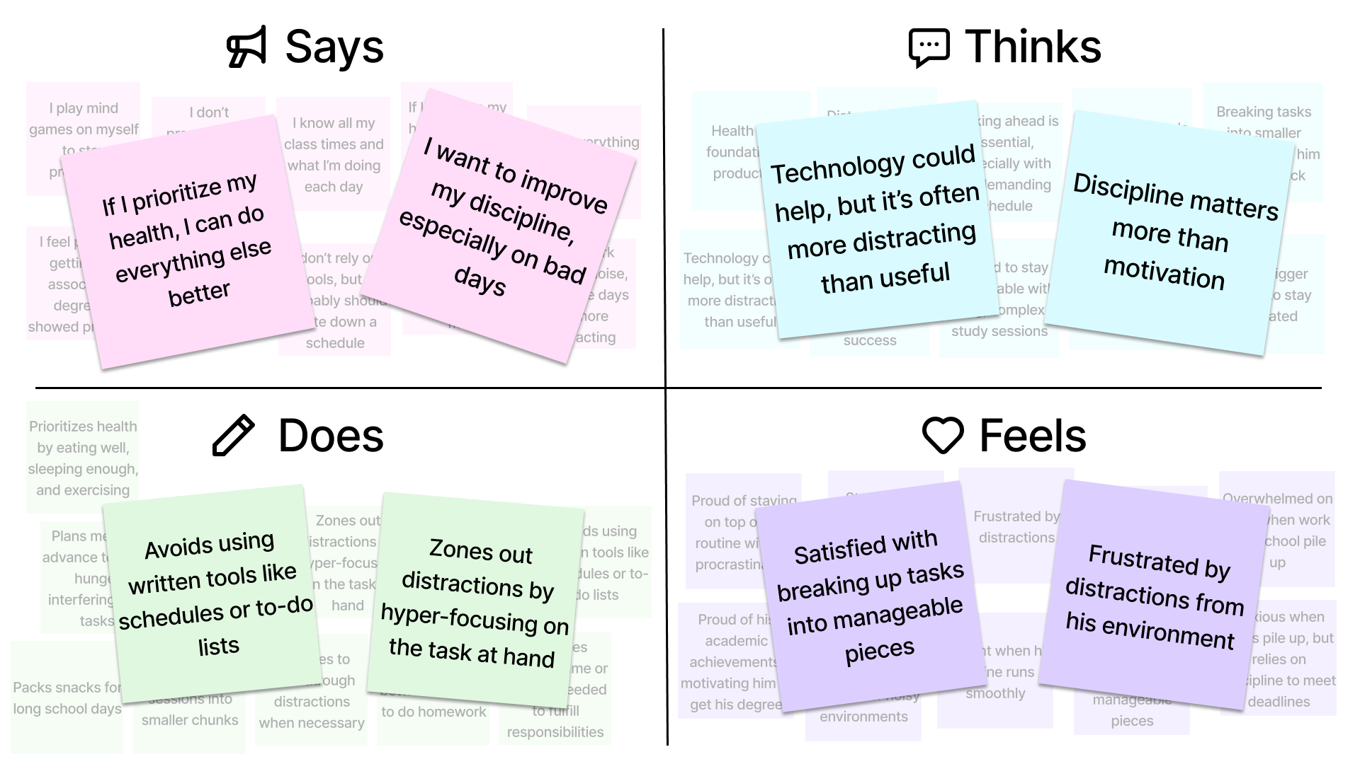
Empathy Map: JJ
DOMAIN SELECTION
A1: NEEDFINDING

Slide 34
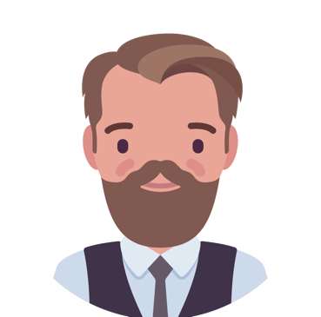
RESULTS & ANALYSIS
A1: NEEDFINDING
Insight
Some users rely primarily on internal discipline and mental routines to stay accountable, rather than using external tools or apps. However, unpredictable schedules and external obligations can disrupt their accountability, and they may struggle when their discipline is tested on challenging days.
Need
Users need supportive tools that enhance their internal strategies without adding distractions. Tools should seamlessly integrate with their mental routines, help manage unpredictability, and reinforce their focus and health priorities.

Slide 35
RESULTS & ANALYSIS
A1: NEEDFINDING
Key Quote
“I don't procrastinate much at all, so I don't really have to keep myself very accountable anymore—it's like kind of built in. It's my routine already.”
Surprises
Minimal use of tools
Health first but would sacrifice meals and sleep if needed
Adapted to distractions by hyper-focusing on tasks

Slide 36
NEEDFINDING METHODOLOGY
A1: NEEDFINDING
Extreme Users
Ann uses paper notes and prefers to avoid social media whenever possible. Being retired, she has less work obligations to actively keep track off.
Madison uses to-do list apps to track her tasks and obligations, often relying on her phone to remember everything on her plate.
Ann
66 yrs old
Retired Librarian
Santa Clara, CA
Madison
21 yrs old
ROTC Nursing Student
+ Business Owner
South Orange, NJ

Slide 37
NEEDFINDING METHODOLOGY
A1: NEEDFINDING
Extreme Users
Andrew does not have a formal accountability system and instead relies on internal motivation. He procrastinates as much as possible.
JJ maintains accountability through mental discipline rather than tools, prioritizing health to stay productive. He avoids procrastination by sticking to a structured routine.
Andrew
17 yrs old
High School Senior
Raleigh, NC
JJ
22 yrs old
College Student + Caregiver
San Francisco, CA

Slide 38
A1: NEEDFINDING
Conclusion

Slide 39
CONCLUSION
A1: NEEDFINDING
Putting it all together
01
03
Stability and Consistency Users value systems that provide stability in their routines. The app should ensure users can rely on it without needing to overhaul their habits or adjust to overly complex features.
Support Existing Habits Users seek tools that align with their current systems, providing a sense of control and independence. The app should be intuitive and integrate with the workflows people already use.
02
04
Flexibility and Adaptability
Users acknowledged that flexibility is essential when things don’t go as planned. The app should allow users to adjust their goals and tasks while still feeling in control.
Minimal Intrusiveness
Users like subtle reminders orp prompts to help stay on track without being overwhelming. The app should foster accountability without being overbearing.

Slide 40



CONCLUSION
A1: NEEDFINDING
Challenging Assumptions
Importance of getting outside the Stanford bubble
Challenging our assumption on the importance of technology & productivity
Andrew is selectively motivated
JJ uses no technology, but is very disciplined
Madison uses technology, but gets distracted

Slide 41
MAJOR FINDING 1
DETAILS
What’s Next?
More Interviews
Identify Patterns
Narrow Scope
We will interview more users who provide unique perspectives on the topic of social accountability. We aim to talk to more users with diverse backgrounds and lifestyles.
We will continue to analyze the insights and trends in our interviews. We will use these to explore possible needs and develop HMWs to better inform our project moving forward.
We will take all of our learnings and narrow the scope of the problem within social accountability that we are looking to build a solution for.

Slide 42
A1: NEEDFINDING
Thank You!

Slide 43
Appendix

Slide 44
APPENDIX
A1: NEEDFINDING
Questions
What do you currently do for a living?
Could you tell me about how you currently keep accountable?
What are some of the things you try to stay accountable for?
How do you decide which tasks are the most important to stay accountable for?
Have you ever tried a tool that didn’t work for you? Why didn’t it work?
What are some of the biggest challenges you face when keeping accountable?
What external factors lead you to lose accountability?
In what ways does your environment (physical or digital) impact your ability to stay accountable?
Are there any particular settings or situations where you find it easier or harder?
How do you feel when you fall behind on tasks?
What motivates you to stay accountable for certain tasks or responsibilities?
What habits or practices have you developed over time to improve your accountability?
Describe a time when you felt really proud of staying accountable. What helped you succeed?
How do you think technology could help you better stay on track?
If you could wave a magical wand and improve any aspect of your accountability, what would it be and why?

Slide 45
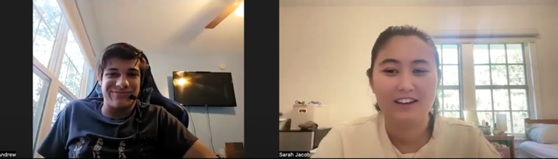
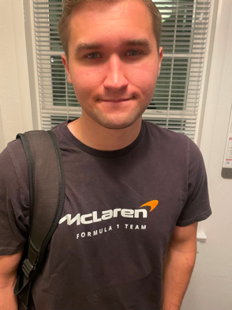

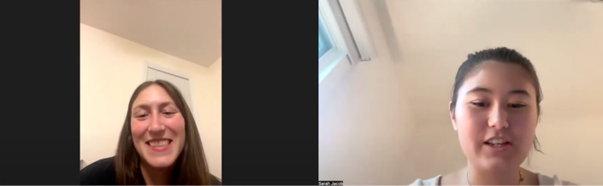


Interview Artifacts

